Slide 2
2D Animation with Anima2D
Notes:
Good evening, today we will talk about the future of 2D Animation in Unity. As you may have heard, we acquired and made free the Asset Store package: Anima2D. The ultimate goal solve the problem of animating 2D characters and objects in Unity in an efficient way.
Description for translators:
This presentation will focus on the 2D animation workflow we have right now in Unity, using the plugin called: “Anima2D”, we will also cover the differences between “Frame by Frame” animation and “Skeletal Animation”, the goal of this part is to know what are the pros and cons of each one.
I will also demo the setup for a 2D character using the Anima2D plugin, which will consist on opening Unity and setting up objects to create a “rig”, and “animations”.

Slide 3
Arturo Nereu Evangelist, Unity Technologies @ArturoNereu
Notes:
My name is Arturo Núñez, I work as a product evangelist for the Latin American region and before joining Unity I was working at game studios mostly in 2D games. So I know the struggles of having to use a 3D engine to make 2D games.

Slide 4
Objectives
At the end of the presentation, you will be able to:
Select the best animation technique for your game based on artistic and technical constraints.
Animate a 2D humanoid character in Unity using Anima2D.
Understand where Unity 2D animation tools are heading to.
Notes:
Here, we will mention the main objectives of attending the talk.

Slide 5
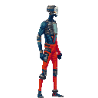
Animation
The Illusion of Life
Notes:
This slide is to define what the purpose of animation in games is. Which is simulate that the characters and other elements in the game are alive.
The animation is known also as the illusion of life, which basically transforms unanimated drawings or models into living characters. No matter which animation technique we end up using, the goal is to always have a consistent animation that makes the player he is inside the video game.
If for any reason, the animation fails (breaks, is not good enough, drops frames, etc) the player will feel disconnected from the game and will start thinking about it as a piece of software. We want to avoid that.

Slide 6
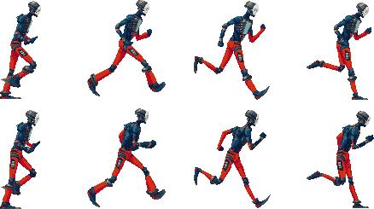
Frame by Frame Animation
Sprite Renderer
Notes:
We will start covering the technique called “Frame by Frame” animation, which has been around in the films and cartoons industry for quite some time. In this technique, we are basically flipping through the pages of a notebook. Where each page contains a part or frame of the animation with a small change with respect to the previous one.
In games, what we usually have, is a large texture called a Sprite Sheet, and what we do is to draw a frame of the texture during a period of time, then after x time passes, we switch to the other one and this gives the illusion of movement.

Slide 7
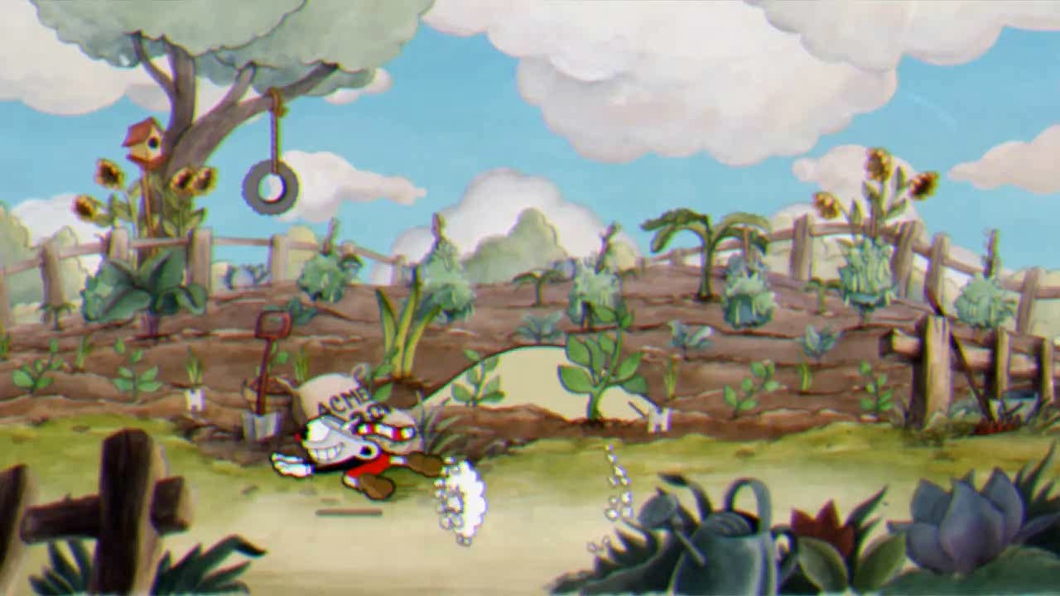
Notes:
This game is CUPHEAD by Studio MDHR, I will let the video run and after it finishes I will explain that the game is being drawn frame by frame. Which is the only way to achieve the aesthetics the developer wants, but it also takes more time since the process of drawing each frame and changing it needs to be manual.

Slide 8
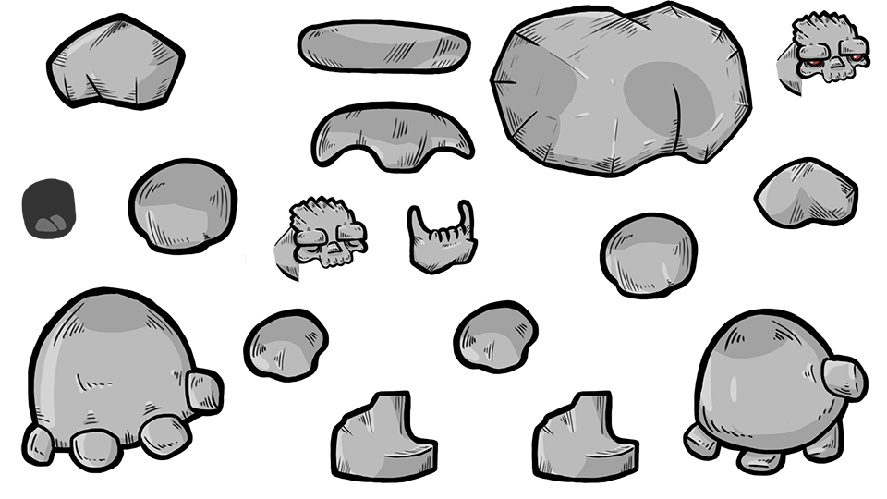
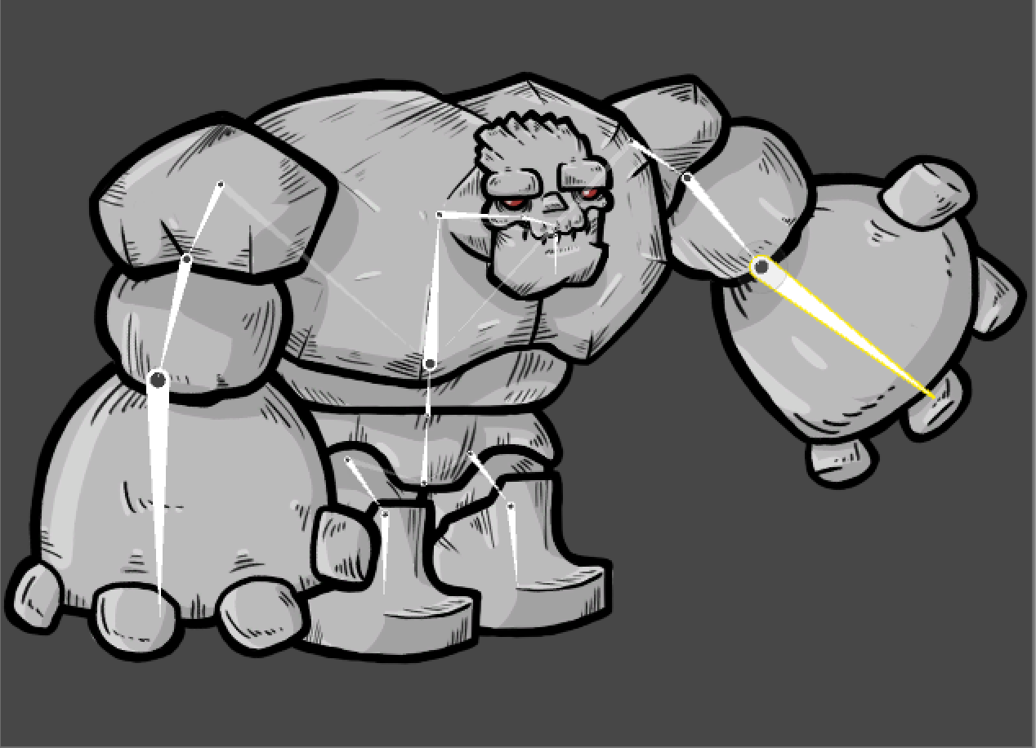
Skeletal Based Animation
Notes:
This is the other technique, called the skeletal based animation. It is called like this because we will create a skeleton for our characters, and the skeleton will be animated (with keyframes), thus, the images that are attached to those bones, will move when the bone moves accordingly.
As a quick note, this technique allows us to have a high number of animations without increasing the build size, which is important. However, the animation takes place on the CPU we need to consider this.
We will discuss more about this in a couple of minutes.

Slide 9

Notes:
Here, I will show a video from a Game that uses skeletal based Animation. Will just play it and then explain bits of how this could be achieved with the skeletal animation technique.

Slide 10
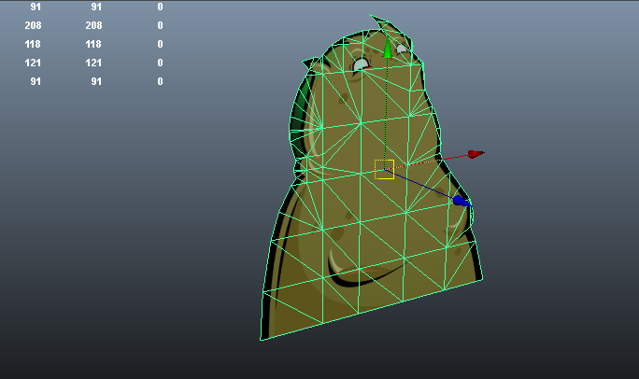
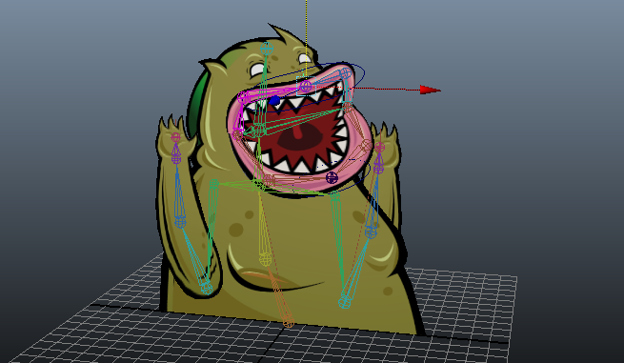
The Old Days
Notes:
A few years ago, when Unity’s 2D capabilities were not as advanced as today, if you wanted to do something like a Skeletal based option. You needed to either use a plugin or use a 3D model made out of planes to simulate the cut-outs and bone animations.
In a nutshell it worked for some cases, but for some others such as the example shown. It meant a lot of overhead just for animations, plus the result was not as expected and modifications needed to happen in an outside software.

Slide 11
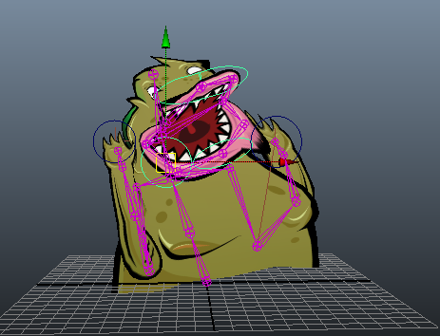
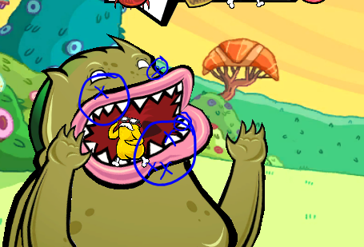
The Old Days
Notes:
Here we see, that the rig(blue skeleton) is really a 3D rig, that holds a transform for a three dimensional object that we won’t actually use.
And on the right side, we can see some issues, such as jagging that if we want to get rid off, we would need to send more overhead to the CPU-GPU.

Slide 12
Frame by Frame Animation | Skeletal Animation
Large textures, more memory. | Simple Atlases, more CPU overhead
Inflexible for changes. | More flexible for changes.
Smoothing requires more frames. | Smoothing is based on time and CPU.
No blending* | Animation blending can be achieved.
Great Performance | Great Memory Saver
Detailed and complex animations. | Animations that are simple-software driven.
Good for small objects | Good for Large objects
Notes:
Here, I will discuss advantages and disadvantages of one method over the other. The important thing to note is that no method is better than the other. It depends on what the developer wants to achieve and the resources constraints she may have.

Slide 13
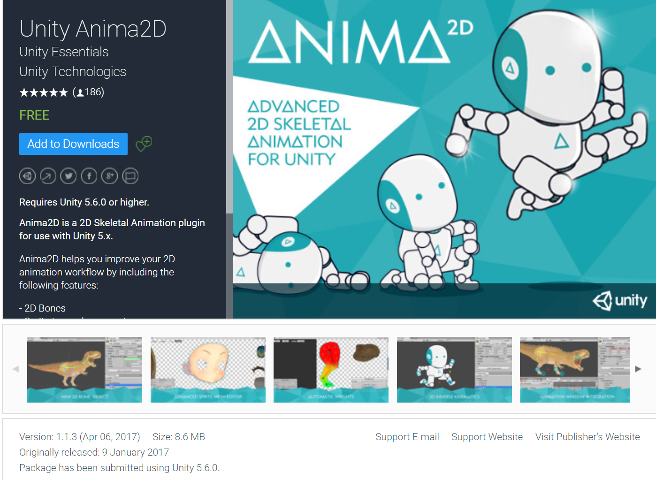
Anima2D
Skeletal Animation Plugin for Unity.
Free on the Asset Store.
Fits into current Unity’s pipeline.
C# source code included.

Slide 14
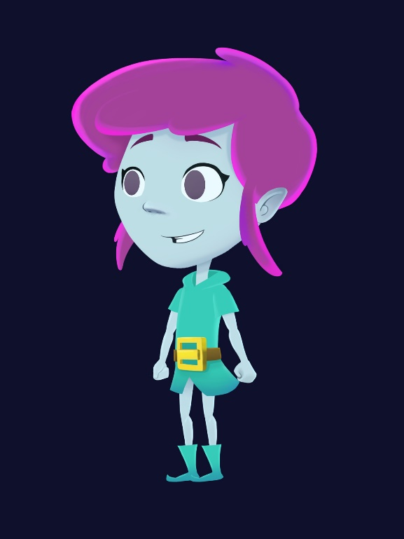
Anima2D Demo

Slide 15
Where are we heading to?
- 2D Character rigging workflow will be focused in the Sprite Editor. This provides a smoother and neater workflow.
- Create edit bones, hierarchy of bones.
- Auto and manual mesh tessellation
- Auto and manual vertex weight assignment
- Free Form Deformation
- Inverse Kinematics

Slide 16

What’s coming?

Slide 17
References
Slides and demo Project:
https://github.com/ArturoNereu/Unity2DAnimation
Anima2D Package:
https://www.assetstore.unity3d.com/#!/content/79840
2D Skeletal Animation for Unity – Unite Europe
https://youtu.be/IQ8ZbZoXCcg

Slide 18
Thank you!

